Slide 1

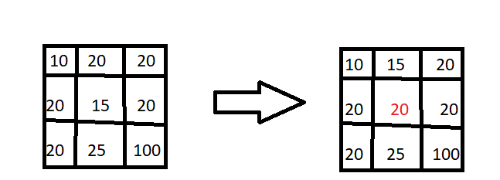
Digital Image Processing
20-Give an example by numbers on how the median filter work.
What kind of noise median filter is most famous of enhancing.
For example, suppose that a 3*3 neighbourhood has values (10, 20, 20, 20, 15, 20, 20, 25, 100)
Arrange numbers (10,15,20,20,20,20,20,25,100)
Median = 20
Kind of noise:
Salt and pepper noise

